Slide 1
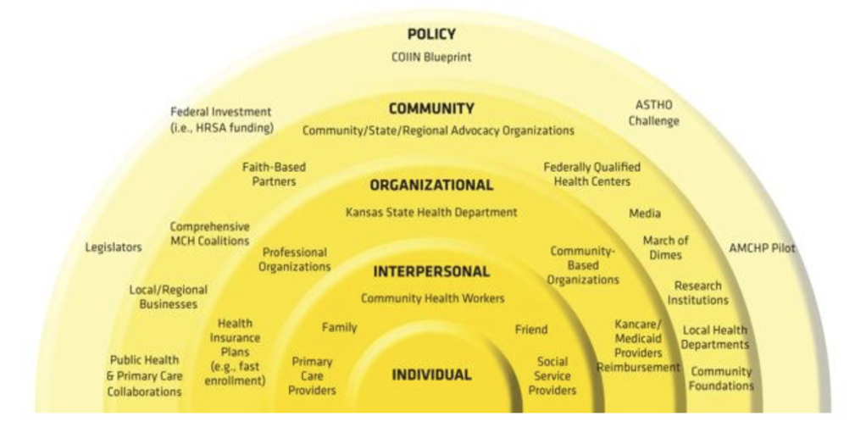
Women’s Health Network: An Evaluation of a Community Program
Inneké L. Vargas, Nikki Keene Woods, PhD, Melody McCray-Miller, Amy K. Chesser, PhD
Wichita State University
Introduction
Methods & Results
Discussion
Women’s health outcomes have an overarching effect on community health and wellness. This study explores the creation of a network focused on community healthcare access for high-risk vulnerable populations across the state of Kansas. We will examine the following:
Board membership and representation
Identifying healthcare needs
Recruitment
Data collection
Findings
Future
The goal of this initiative is to improve healthcare access and assess the efficacy of educational intervention on health disparities.
Short Term:
Appoint Board of Directors
Identify high-priority health disparities
Create Network connections
Methodology: info on how we gathered the info and more method info etc.
Long Term:
Build community trust
Break down community and institutional silos
Facilitate the creation of a women’s health network of trusted providers
Create continuing education opportunities for providers and organizations
Board Creation
Principal investigators made connections with possible board members
Criterion:
Member of, or provider to, underrepresented groups
16 Board members were recruited including:
Medical providers, social service workers, community members, and organization representatives
Data Collection
29 question Qualtrics survey
Demographic data gathered (Table 1)
Qualitative data gathered to determine health concerns of focus (Table 2)
Open forum discussion
Major Health Concerns by Age Group
 | Highest Reported | Also Reported
What do you think are the most important health issues for young women (age 10 - 18) in the state of KS? | Reproductive health Mental health Health literacy Reproductive knowledge | Diabetes Obesity Domestic violence Sexual assault prevention
 | Highest Reported | Also Reported
What do you think are the most important health issues for women (age 19 - 30) in the state of KS? | Reproductive health Mental health Health literacy Sexually transmitted infection prevention | Dating violence prevention Substance abuse Domestic violence prevention Right to choose
 | Highest Reported | Also Reported
What do you think are the most important health issues for women (age 31 - 40) in the state of KS? | Reproductive health Mental health Health literacy Self-care | Breast cancer awareness Health promotion instead of disease treatment 100% Well woman visit coverage
 | Highest Reported | Also Reported
What do you think are the most important health issues for women (age 41 - 50) in the state of KS? | Reproductive health Mental health Health literacy Self-care | Understanding health as we age Access to healthcare 100% Coverage of mammograms
 | Highest Reported | Also Reported
What do you think are the most important health issues for adult women (age 51-65) in the state of KS? | Reproductive health Mental health Health literacy | Access to healthcare Heart health education Staying active
Table 2.
Network members are being recruited via:
Board recommended partnerships
Word of mouth
Network event invitations
Network events include keynote presentations and networking events
Investigators to hold patient round table discussion panels to:
Gather qualitative data
Understand the patient experience in the current Kansas healthcare system
Share best practices
Other large-scale studies have implemented similar recruitment and analysis profiles that support the creation and efficacy of women’s health initiatives and their positive community health outcomes (Hays et al., 2003).
Future focus will involve broadening the demographic scope of the Board of Directors to include:
Age > 65
Employment status
Part time
Retired
Unemployed
Education
Include lower than post-graduate degrees
Racial/Cultural Diversity
Add racial self-reporting to Qualtrics surveys
Intellectual & Developmental Delays
Health literacy disparities
Health proxy options
LGBTQ+
Differing health needs
The Board of Directors identified these health concerns as spanning each patient age bracket from 10 to 65:
Mental health
Reproductive health
Health literacy and access to education
The Women’s Health Network is on target to diversify Board Member involvement and Network recruitment. The Network clearly fills a needs in the community and is a necessary resource for improving women’s healthcare in Kansas
Hays, J., Hunt, J. R., Hubbell, F. A., Anderson, G. L., Limacher, M., Allen, C., & Rossouw, J. E. (2003). The women’s health initiative recruitment methods and results. Annals of Epidemiology, 13(9), S18–S77.
Patient Centered Outcomes Research Institute (PCORI) Eugene Washington PCORI Engagement Award 10663-WichSU
Limitations & Future Direction
Goals
Board of Directors Demographics
Sex ( n = 9)
Male | 2 | 22.22%
Female | 7 | 77.78%
Employment status ( n = 9)
Full-time | 9 | 100%
Age ( n = 9 )
15 to 24 | 1 | 11.11%
25 to 34 | 2 | 22.22%
35 to 44 | 2 | 22.22%
45 to 54 | 3 | 33.33%
55 to 64 | 1 | 11.11%
Education ( n = 9 )
Advance degree/ Postgraduate | 9 | 100%
Table 1.
Conclusion
Results
Network Recommendations
Over 60 Network alliances formed
Demographics
9 Survey participants out of 13 members
Female: 77.78%
Age: 45 to 54
100% Post-secondary degree
100% Full time employment
Health Concerns
Reproductive health
Health literacy & Access to education
Mental health
References & Funding

